Slide 1
ROS Tutorial II
Lily, 2020/3/23

Slide 2
Outline
Service
roslaunch
Apriltag

Slide 3
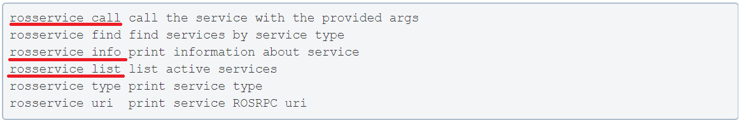
Service
Publisher / Subscriber is a good model
But what if we want request / response behavior?
Services do this for you!
You can create your own service just like message
Command line tools

Slide 4
Topic 1

Slide 5
roslaunch
So, we use so much terminal to run our nodes / start a master / play bag
Is there an easier way?
YES! What you need is 'roslaunch'
It is a tool that makes you
start a master
run multiple nodes locally and remotely
set parameters
launch file is a XML file with many tags you will use
Can also include other launch files

Slide 6
Apriltag (1/2)
apriltag_ros from RIVeR
Inputs:
image
camera_info (extrinsic / intrinsic matrix)
tag_size (size of black bolder)
Outputs:
tag_detection_array
ID
size
pose
TF

Slide 7
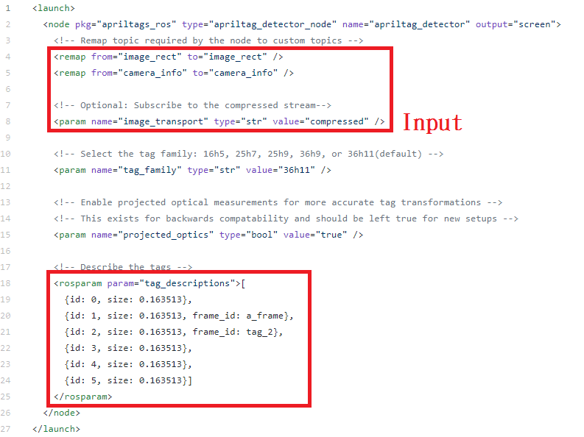
Apriltag (2/2)
How to use
Modify example.launch for your usage

Slide 8
Topic 2

